Slide 1
Fake News Detection Python Project

Slide 2
FAKE NEWS:
A type of yellow journalism, fake news encapsulates pieces of news that may be hoaxes and is generally spread through social media and other online media. This is often done to further or impose certain ideas and is often achieved with political agendas. Such news items may contain false and/or exaggerated claims, and may end up being viralized by algorithms, and users may end up in a filter bubble.

Slide 3
TF & IDF Vectorizer :
TF (Term Frequency): The number of times a word appears in a document is its Term Frequency. A higher value means a term appears more often than others, and so, the document is a good match when the term is part of the search terms.
IDF (Inverse Document Frequency): Words that occur many times a document, but also occur many times in many others, may be irrelevant. IDF is a measure of how significant a term is in the entire corpus.
The TfidfVectorizer converts a collection of raw documents into a matrix of TF-IDF features.

Slide 4
Passive Aggressive Classifier :
Passive Aggressive algorithms are online learning algorithms. Such an algorithm remains passive for a correct classification outcome, and turns aggressive in the event of a miscalculation, updating and adjusting. Unlike most other algorithms, it does not converge. Its purpose is to make updates that correct the loss, causing very little change in the norm of the weight vector.

Slide 5
Detecting Fake News with Python :
To build a model to accurately classify a piece of news as REAL or FAKE.

Slide 6
About Detecting Fake News with Python :
This advanced python project of detecting fake news deals with fake and real news. Using sklearn, we build a Tf Ifd Vectorizer on our dataset. Then, we initialize a Passive Aggressive Classifier and fit the model. In the end, the accuracy score and the confusion matrix tell us how well our model fares.

Slide 7
The fake news Dataset :
The dataset we’ll use for this python project- we’ll call it news.csv. This dataset has a shape of 7796×4. The first column identifies the news, the second and third are the title and text, and the fourth column has labels denoting whether the news is REAL or FAKE

Slide 8
Import Libraries :
In this first step, we would import all the libraries required for this project.
Numpy
pandas
sklearn

Slide 9
Steps for detecting fake news with Python:
Make necessary imports:
import numpy as np
import pandas as pd
import itertools
from sklearn.model_selection import train_test_split
from sklearn.feature_extraction.text import TfidfVectorizer
from sklearn.linear_model import PassiveAggressiveClassifier
from sklearn.metrics import accuracy_score, confusion_matrix

Slide 10
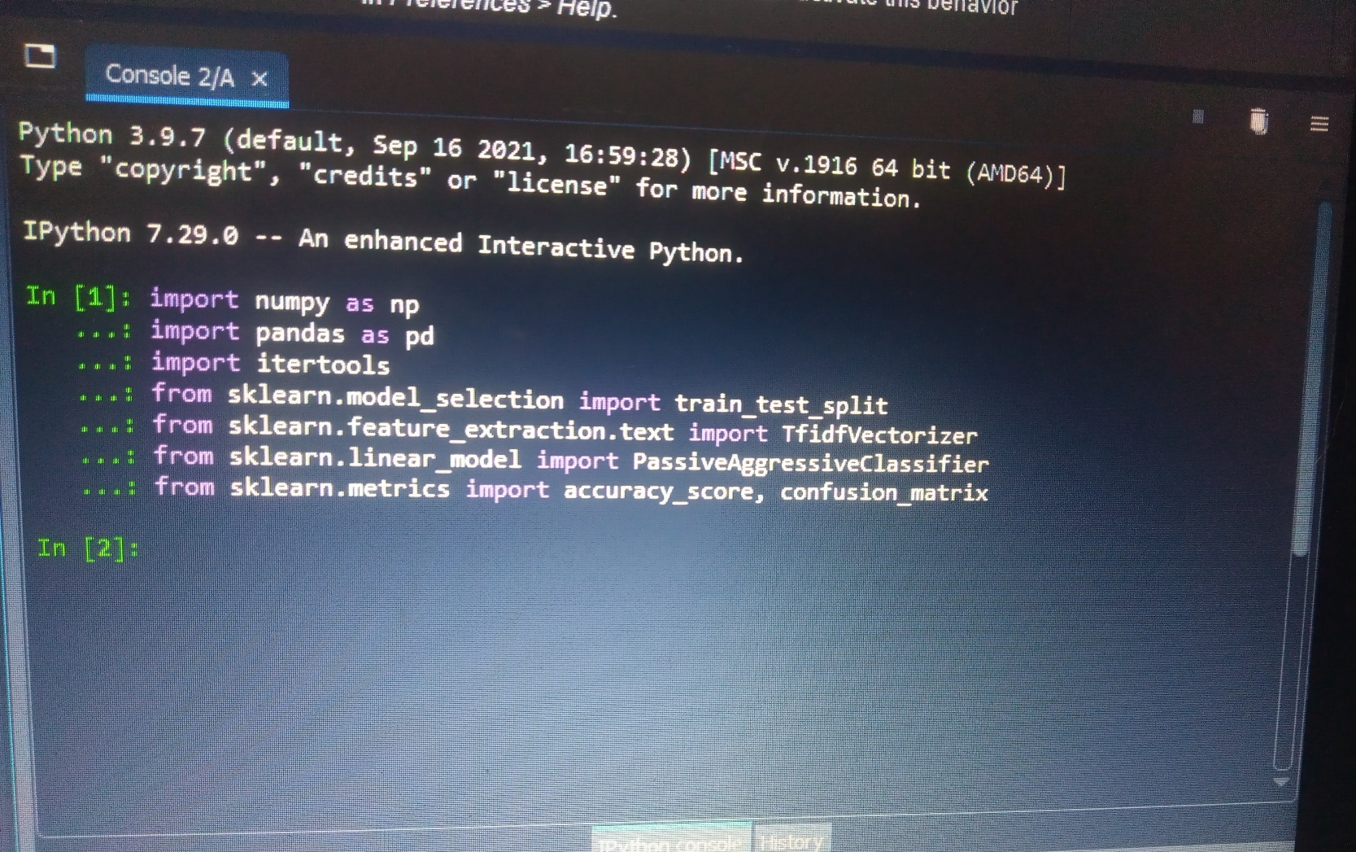
Screenshot:

Slide 11
2. Now, let’s read the data into a DataFrame, and get the shape of the data and the first 5 records.
#Read the data
df=pd.read_csv ('D:\\project\\news.csv')
#Get shape and head
df.shape
df.head()

Slide 12
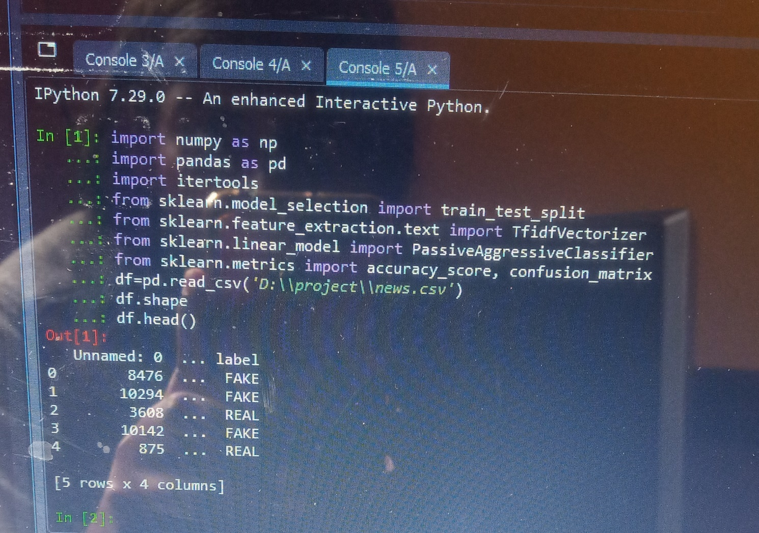
Screenshot:

Slide 13
3. And get the labels from the DataFrame
#project - Get the labels
labels=df.label
labels.head()

Slide 14
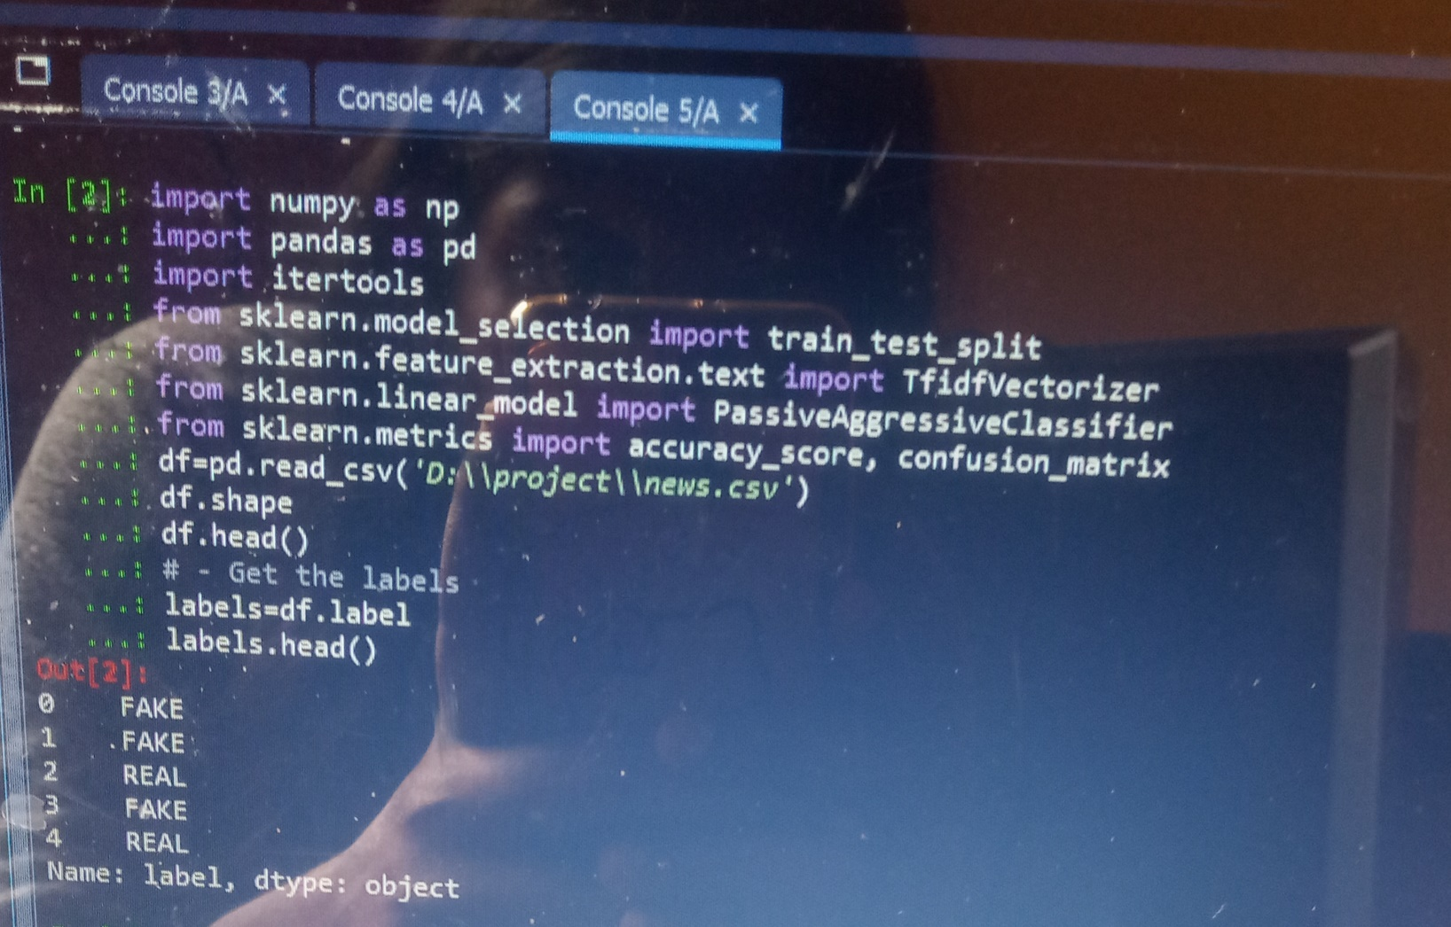
Screenshot:

Slide 15
4. Split the dataset into training and testing sets.
# - Split the dataset
x_train,x_test,y_train,y_test=train_test_split(df['text'], labels, test_size=0.2, random_state=7)

Slide 16
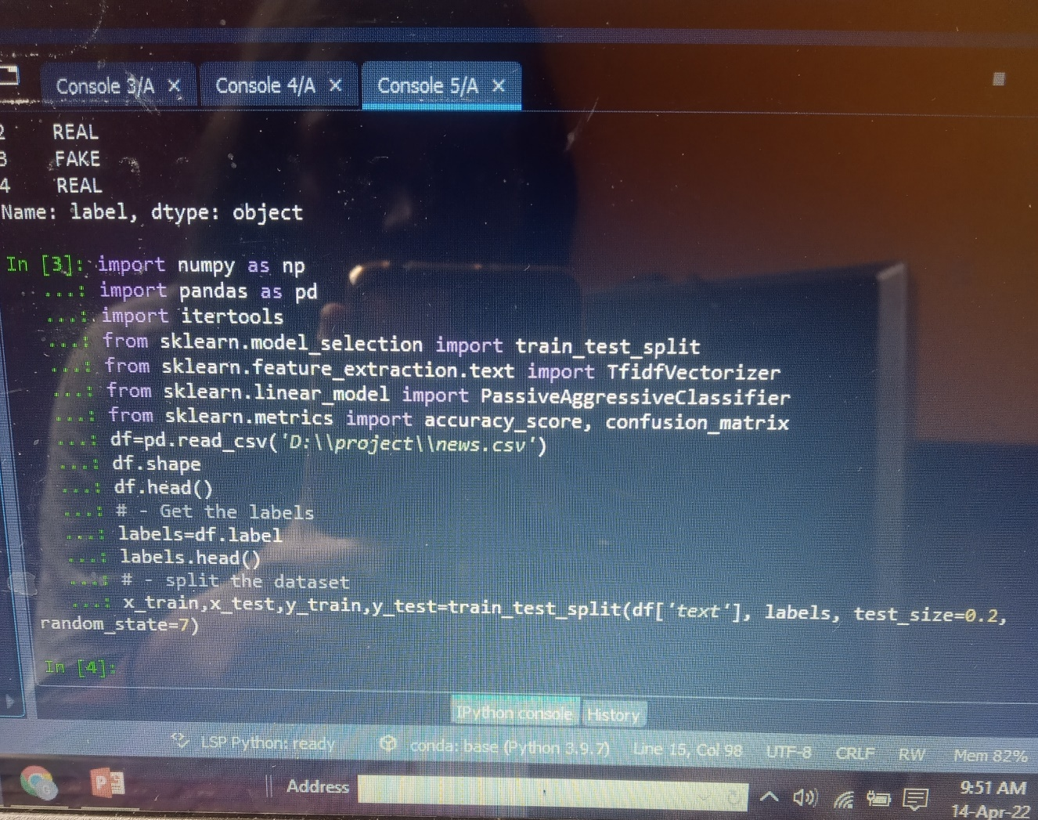
Screenshot:

Slide 17
5. Let’s initialize a TfidfVectorizer with stop words from the English language and a maximum document frequency of 0.7 (terms with a higher document frequency will be discarded). Stop words are the most common words in a language that are to be filtered out before processing the natural language data. And a TfidfVectorizer turns a collection of raw documents into a matrix of TF-IDF features.
Now, fit and transform the vectorizer on the train set, and transform the vectorizer on the test set.
#project- Initialize a TfidfVectorizer
tfidf_vectorizer=TfidfVectorizer(stop_words='english', max_df=0.7)
#project - Fit and transform train set, transform test set
tfidf_train=tfidf_vectorizer.fit_transform(x_train)
tfidf_test=tfidf_vectorizer.transform(x_test)

Slide 18
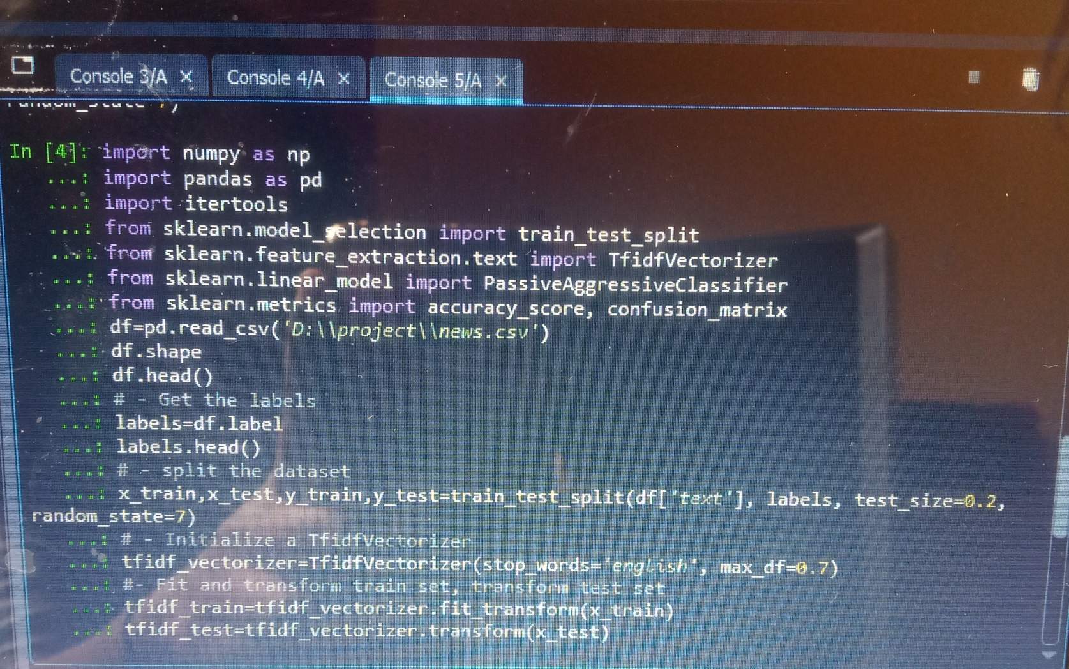
Screenshot:

Slide 19
6. Next, we’ll initialize a PassiveAggressiveClassifier. This is. We’ll fit this on tfidf_train and y_train.
Then, we’ll predict on the test set from the TfidfVectorizer and calculate the accuracy with accuracy_score() from sklearn.metrics
#Project - Initialize a Passive AggressiveClassifier
pac=Passive AggressiveClassifier(max_iter=50)
pac.fit(tfidf_train,y_train)
#Project- Predict on the test set and calculate accuracy
y_pred=pac.predict(tfidf_test)
score=accuracy_score(y_test,y_pred)
print(f'Accuracy: {round(score*100,2)}%')

Slide 20
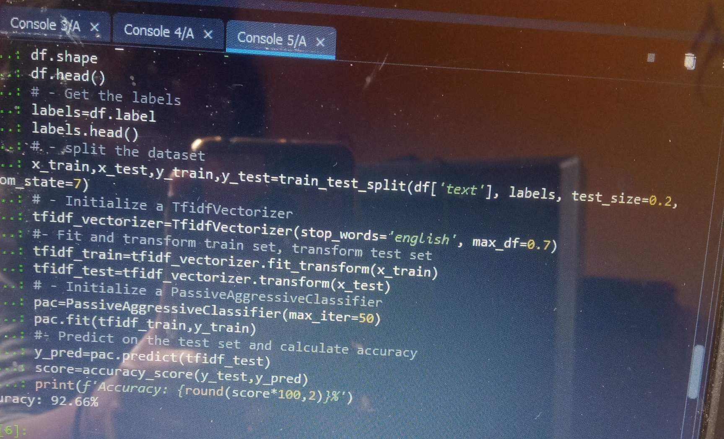
Screenshot:

Slide 21
7. We got an accuracy of 92.82% with this model. Finally, let’s print out a confusion matrix to gain insight into the number of false and true negatives and positives.
#Project - Build confusion matrix
confusion_matrix(y_test,y_pred, labels=['FAKE','REAL'])

Slide 22
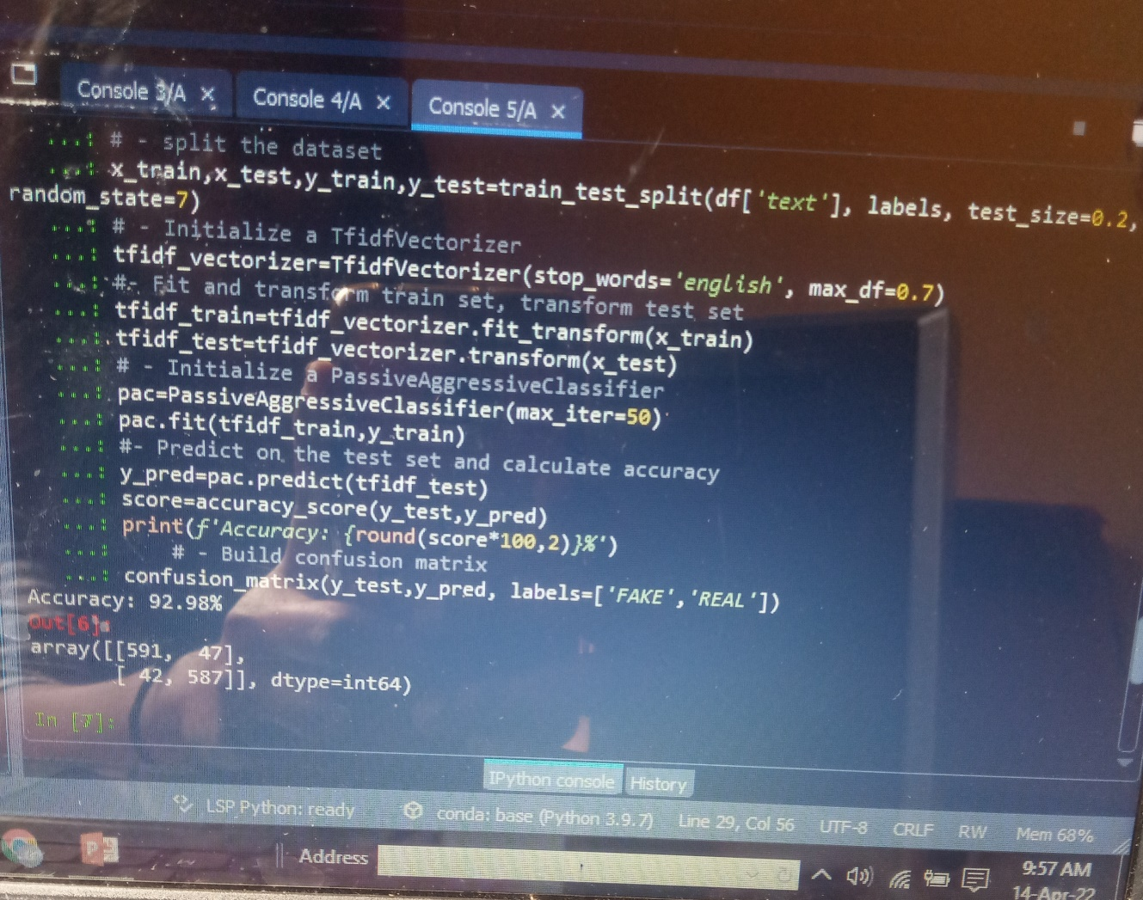
Screenshot:

Slide 23
So with this model, we have 589 true positives, 587 true negatives, 42 false positives, and 49 false negatives.

